Slide 1

Promoting
Healthy Eating
&
Balanced Diet

Slide 2
Agenda:
TEAM MEMBERS
ROLES AND RESPONSIBILITIES
PROBLEM STATEMENT
PROJECT DESCRIPTION
PERSONAS
MVP
TECHNOLOGIES
ARCHITECTURE DIAGRAM
SCHEDULE
RETROSPECTIVE

Slide 3
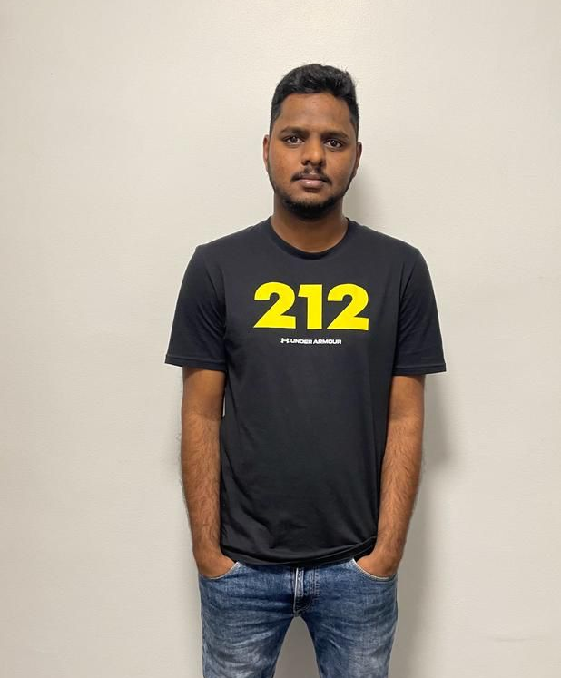
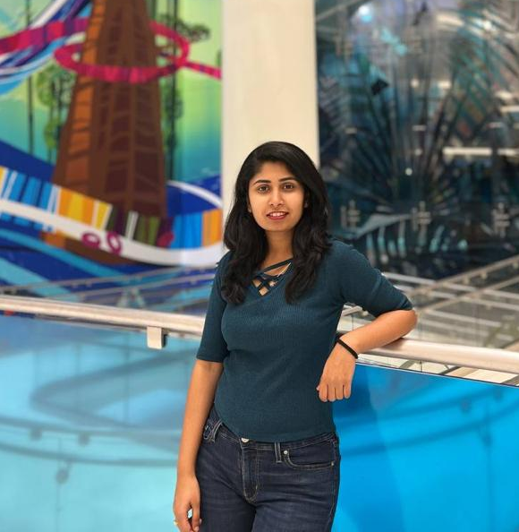
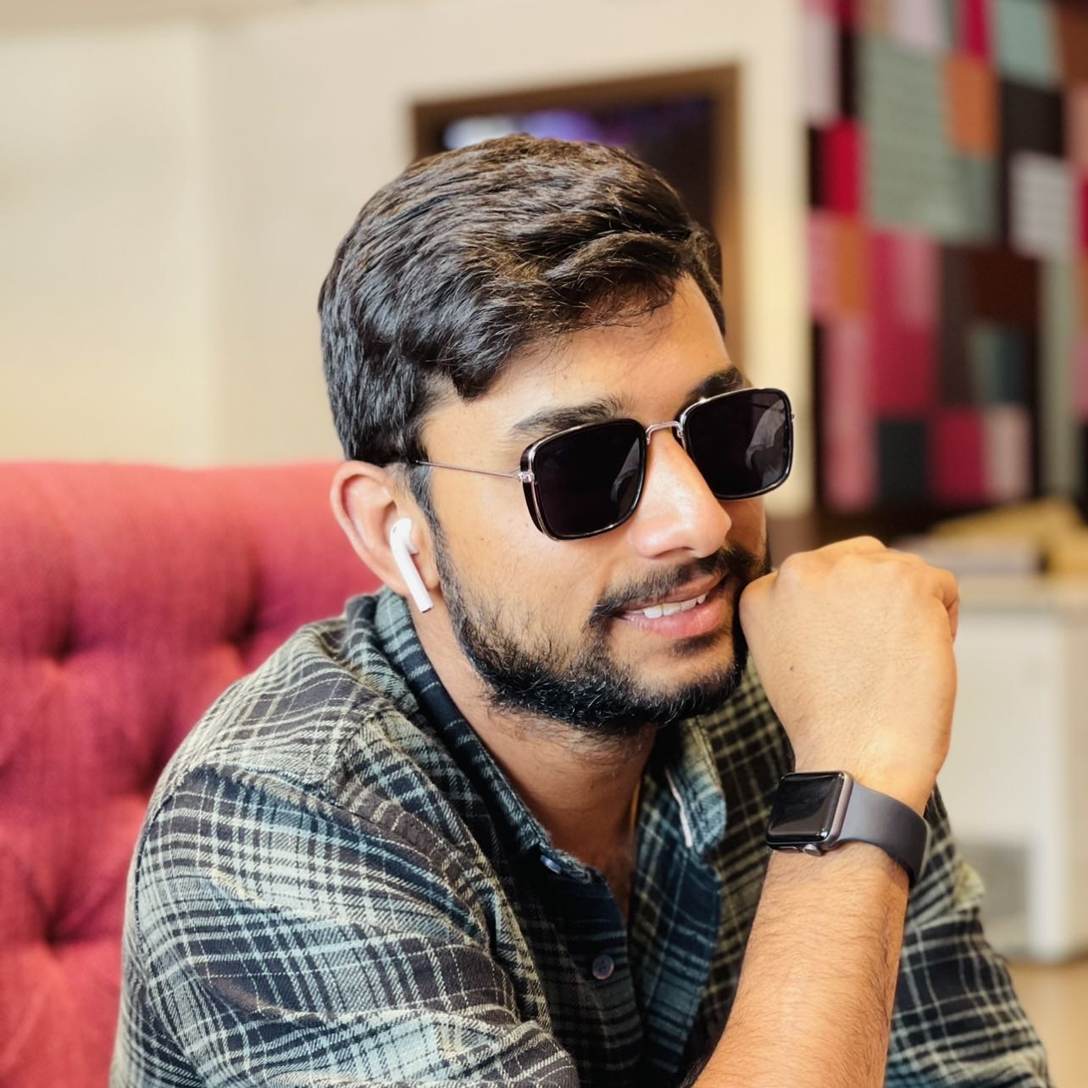
Team Members:
SATHWIK MUDENTI
BACKEND DEVELOPER
BRUNDA REDDY
DATABASE ADMINISTRATOR.
VARUN REDDY DUGGIMPIDI
BACKEND DEVELOPER 2

Slide 4
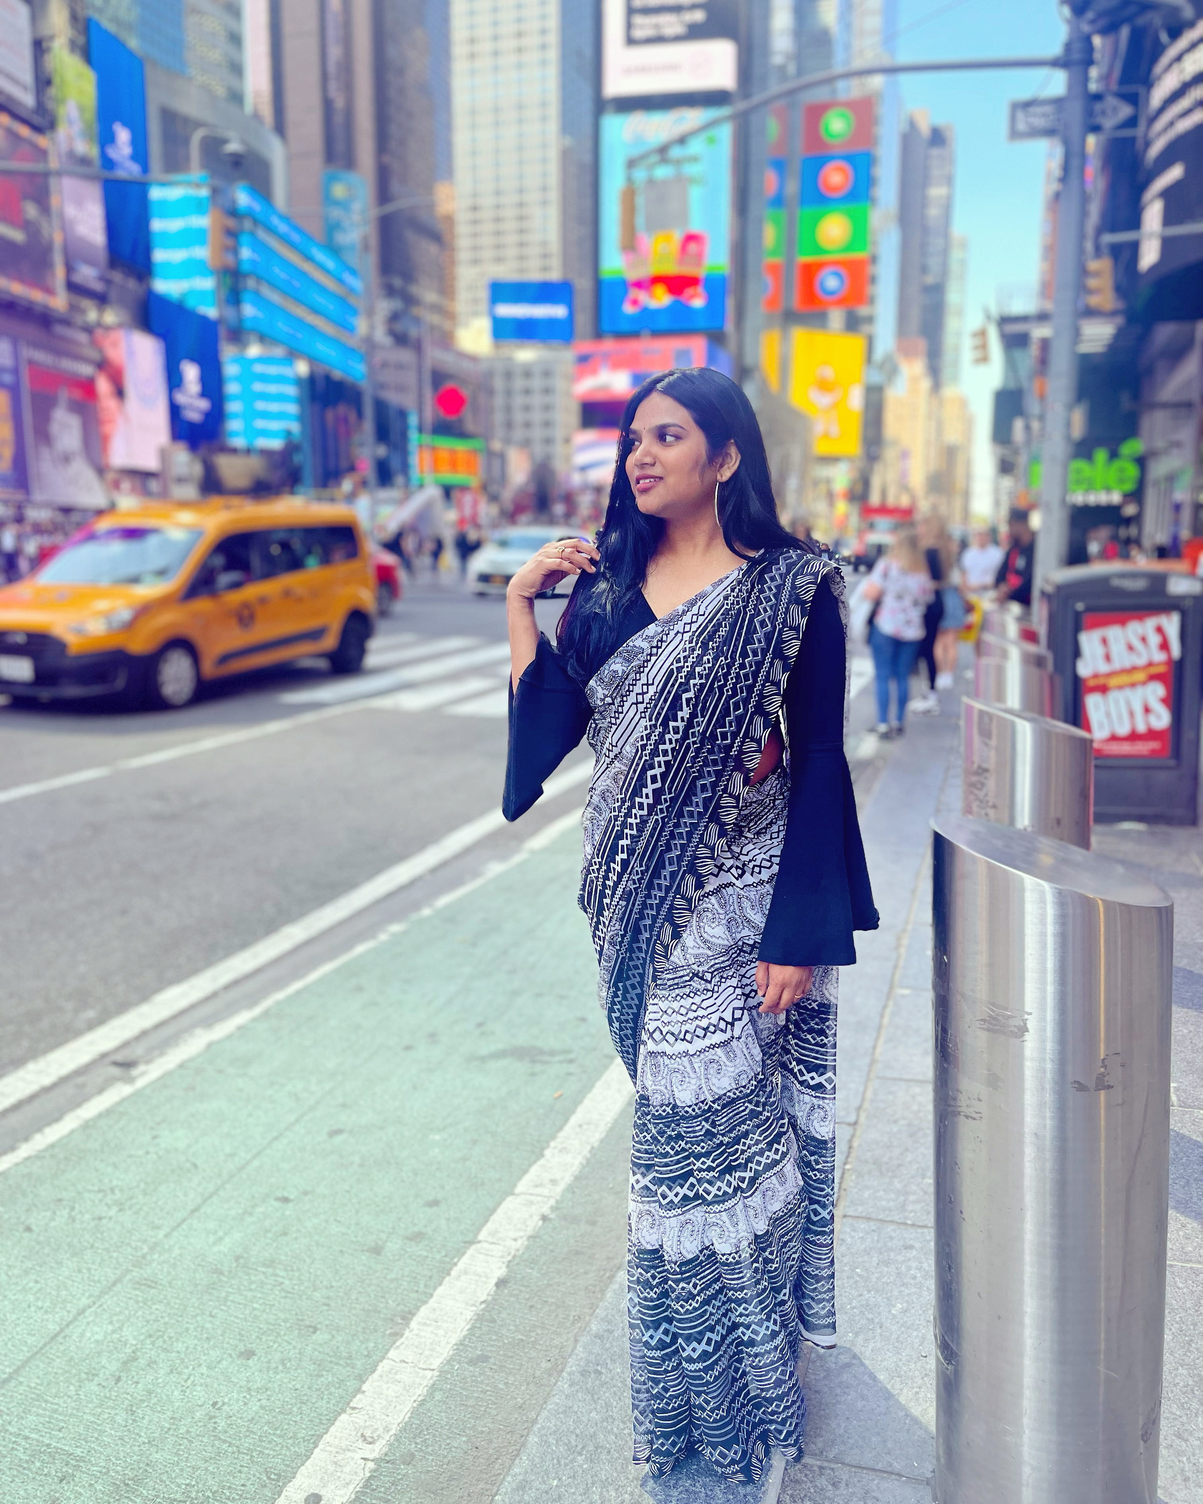
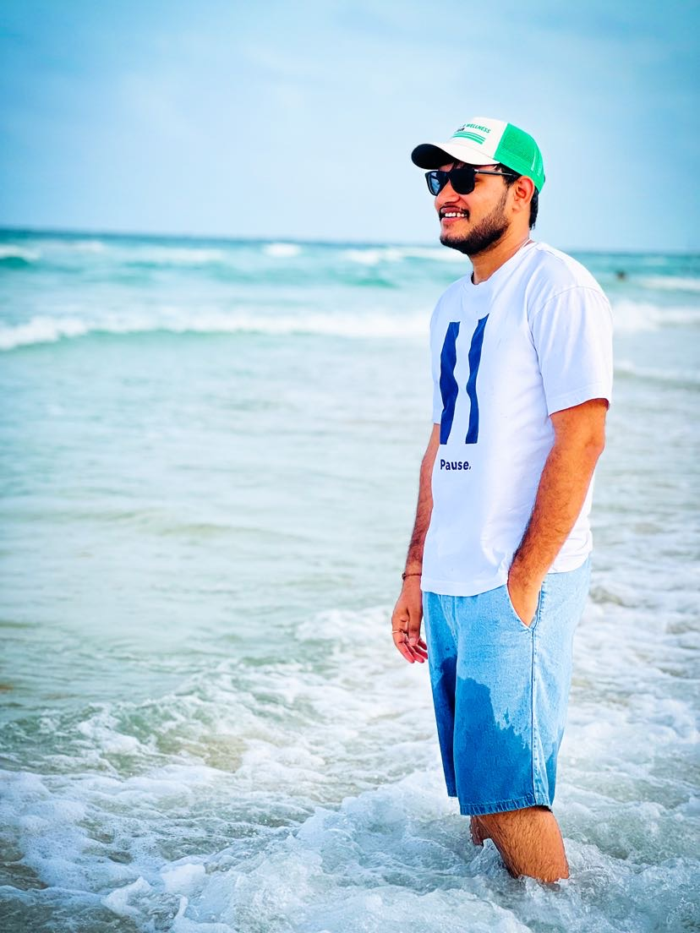
MAANASA DHARINI
FRONTEND DEVELOPER.
CHINTA NARESH BABU
QA/TESTER

Slide 5
Responsibilities:
Our project helps users to track essential data like diet plans, and exercise routines, we can also help users with various health problems, and get expert advice, and other fitness routines to make them stay healthy and fit.
Our project allows users to track diet and exercise regimens, get expert advice, and connect with other fitness enthusiasts to lead a healthy lifestyle.
We take the user's medical history and food allergy data into consideration and provide a unique diet plan based on the data.
When the user cheats on their diet we provide an appropriate fitness routine to compensate their extra calorie intake.

Slide 6
Improvements made from professor feedback:
As suggested by the professor, we have started a new project which is “Promoting Healthy Eating & Balanced Diet.
Our initial project idea was very basic and as suggested by the professor, we have come up with a new project proposal which is “Promoting Healthy Eating & Balanced Diet.
We also decided to change the tools and technologies involved in the project as our previous technologies were primitive.

Slide 7
Problem Statement:
The project focuses on four major problem statements:
Food Classification.
Recipe Generation.
Balanced Diet.
Calorie Estimation.
From the image of food captured, we determine the classification of food (such as donut, samosa, biriyani), identify the calorie count and describe the cooking procedure of the food. With this information, an informed decision can be made on making the item or not.

Slide 8
Food Classification:
Food classification is a challenging problem due to the large number of food categories, high visual similarity between different food categories.
It’s multi-class classification problem to predict the 251 fine-grained food-category label given a food image.
Recipe Generation:
Recipe Generation problem is resolved by three major sub-networks.
Food understanding (Extracting ingredients)
Multi-label classification (Detecting the food title)
Conditional text generation (NLP)(Preparing recipe)
The pipeline extracts the image representation with resnet-50 encoder and obtain the ingredients. Recipes are generated with identified ingredients into human readable format.

Slide 9
Balanced Diet:
A balanced diet is one that contains all of the essential elements that the human body needs.
Carbohydrates, lipids, vitamins, minerals, proteins, fiber and water are all essential components in a well-balanced diet.
A nutritious, well-balanced diet lowers the risk of disease and enhances general health.
Calorie Estimation:
From the ingredients generated from Recipe module, we have computed the Calorie for the dish.
Each recipe provided us the nutritional value for every 100 grams.
Fat/ Saturation - Every gram of fat has 37 kilojoules.
Protein - Every gram of protein has 17 kilojoules.
Sodium - Every gram of sodium has 8 kilojoules.
Sugar - Every gram of sugar has 17 kilojoules.
Every kilojoule has 0.239006 calories.
Using this information we used the following formula to estimate calories.
0.24((fat * 37) + (protein*17) + (sodium *8) + (sugar * 17)) = total calories.

Slide 10
Project Description:
People like to taste different cuisine and choose the most appealing food. They often are concerned about diet restrictions such as gluten-free, vegan, ketosis, peanut-allergy, and calorie count.
We would like to provide an easy solution to making health and good foods that fit your daily calorie consumption limit.

Slide 11
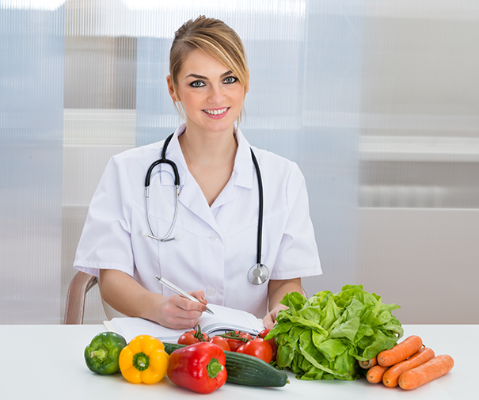
Personas:
Dietitian:
Emma is an expert Dietitian.
She is a qualified health professional who helps
to promote good health through proper nutrition habits.
She is registered with the Commission of Dietetics Registration (CDR)
She has a license to practice as diet and nutritional consultant.

Slide 12
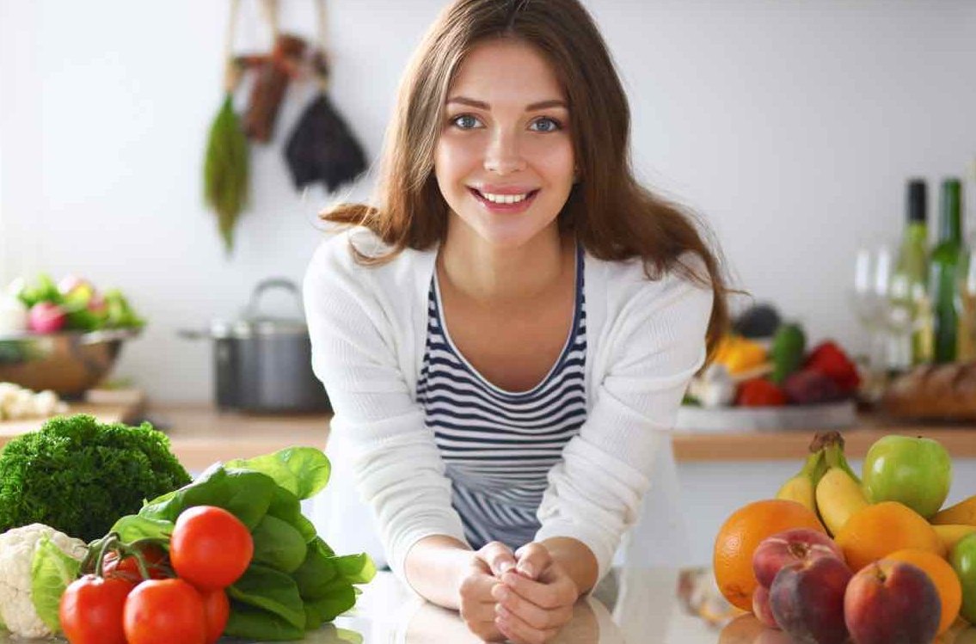
Nutritionist:
She is Hannah.
She works with healthy people to promote healthy eating habits.
She helps in creating awareness to prevent diseases related to nutrient deficiencies.
She uses an online health assessments to curate a daily supplement routine tailored needs.

Slide 13
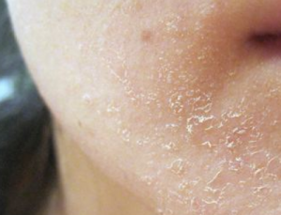
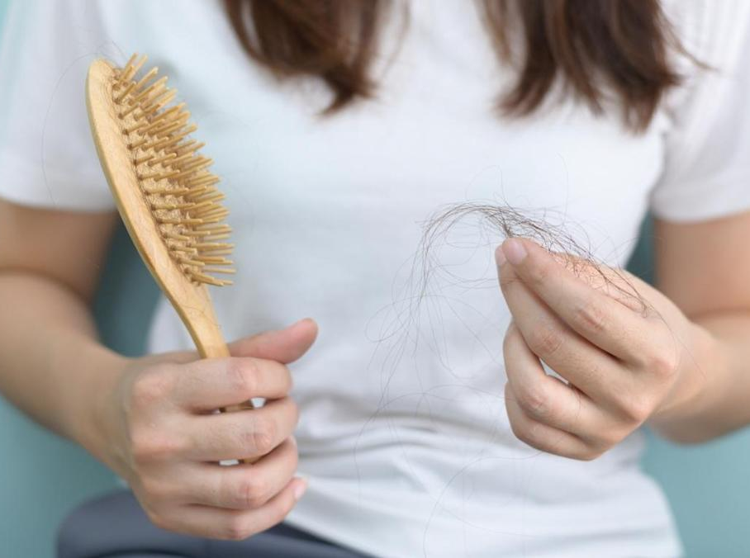
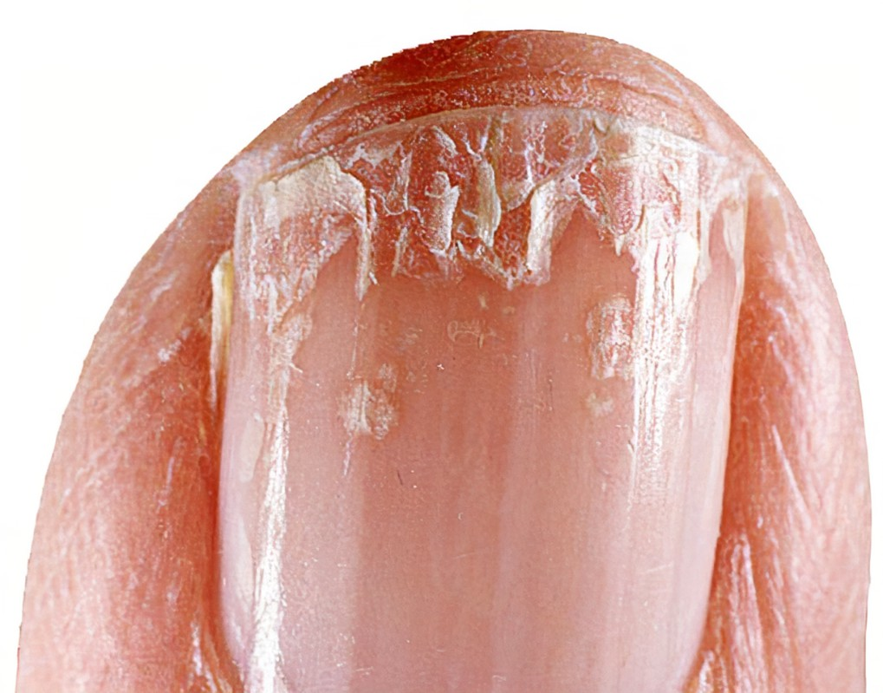
Nutrition Deficiency Patient:
Zoe is 24 years old who is suffering from Nutrition Deficiency
She has signs of B12 and suffering from dry skin, severe hair fall and brittle nails.
She need awareness about a good diet and healthy food habits.
She needs treatments including supplementation, change in diet, lifestyle and eating disorders.

Slide 14
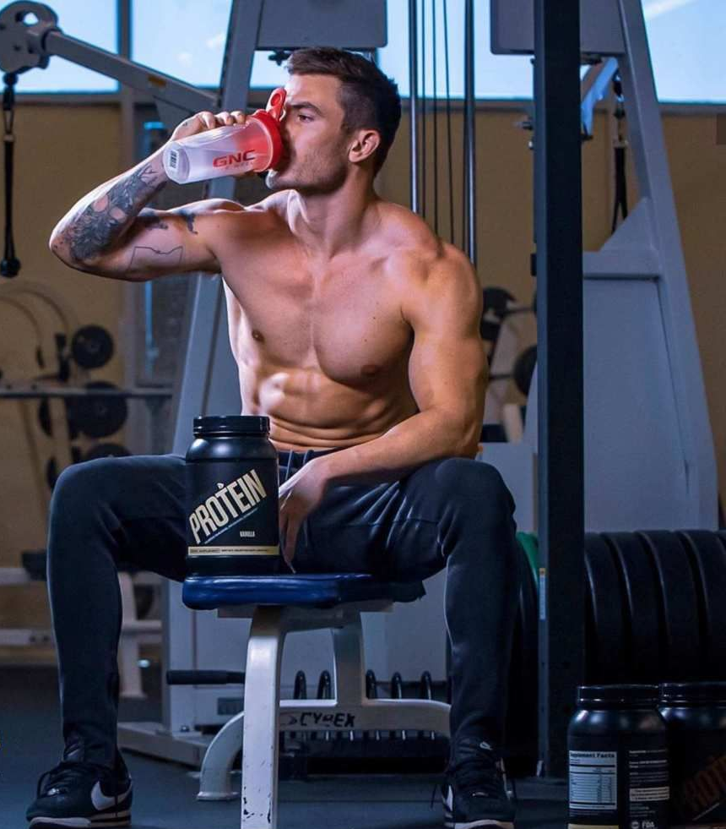
Gym Trainer:
Ryan is a successful personal trainer in one of the best gyms.
He have a good knowledge about what his clients eat is as important as their training regimen.
He helps his client to reach their individual goals.
Ryan knows having the right mix of calories and macros from whole foods is most important.
So, he make an individual diet plan for his clients.

Slide 15
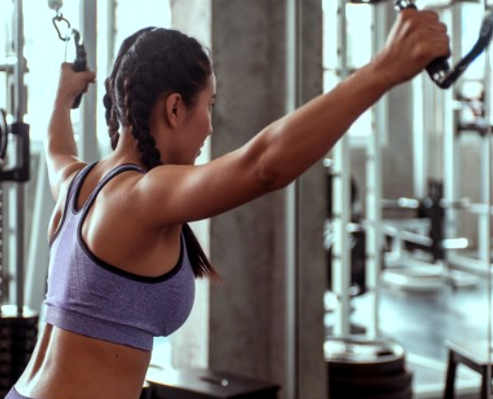
Client:
She is Grace.
Grace is 22 years young and an upcoming model.
Grace loves to be active and physically fit.
She is very much concerned about the food she eat.
She spends 2 hours a day in gym.
She follows a proper diet provided by her trainer.

Slide 16
Minimum Vibal Product:
Our project operates on a freemium model, providing nutritional and fitness advice from nutritionists and fitness coaches.
It is a basic, launchable version of the product that supports minimal yet must-have features which define its value proposition.
It is built with the intent to enable faster time to market, attract early adopters, and achieve product-market fit from early on.
Its development requires careful planning and a customer-focused mindset.

Slide 17





Technologies:

Slide 18
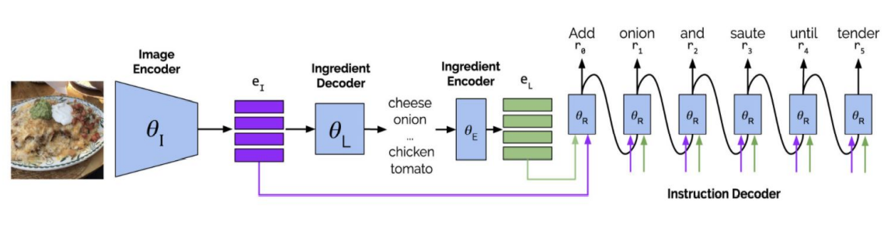
Architectural Diagram:

Slide 19
Product Backlog:
Food classification multi-class classification weights tuning.
Recipe generation pipeline setup was difficult with tensorflow, pytorch and Cuda dependencies version.
Calorie estimation is computed on raw vegetables which we fixed for cooking ingredients.
Merging the inference pipeline for three different modules.

Slide 20
Sprint Backlog:
Sprint 1 (7th Sept 2022 – 27th Sept 2022)
Name | Status | Priority | Estimation Days
Come up with project idea | Done | High | 4
Team Roles | Done | Medium | 4
Github and Wiki Page | Done | Medium | 3
Finish Deliverables 1 | Done | High | 9
Total Days |  |  | 20
Sprint 2 (27th Sept 2022 – 18th Oct 2022)
Name | Status | Priority | Estimation Days
Design acceptance criteria | Done | High | 3
Design Mock Webpage | Done | Medium | 3
Work on Sign up Page | Done | High | 4
Research | Done | Medium | 3
Finish Deliverables 2 | Done | High | 8
Days |  |  | 21

Slide 21
Sprint 3 (19th Oct 2022 – 15th Nov 2022)
Name | Status | Priority | Estimation Days
Draft Technical Paper | Not started yet | Medium | 3
Design Backend | Not started yet | High | 3
Work on Database | Not started yet | High | 4
Finish Frontend | Not started yet | High | 3
Finish Deliverables 3 | Not started yet | High | 8
Days |  |  | 27
Sprint 4 (16th Nov 2022 – 12th Dec 2022)
Name | Status | Priority | Estimation Days
Finish Technical Paper | Not started yet | High | 7
Finish Backend | Not started yet | High | 6
Finish Database | Not started yet | High | 6
Finish Deliverables 4 | Not started yet | High | 7
Total Days |  |  | 26

Slide 22
Teamwork Agreement:
Openness:
To be effective, open sharing with group members is essential to success.
Trust:
It is essential that members trust each others and that is built through honest and open communications.
Conflicts:
A firm agreement should be reached on how decisions triaged and how differences will be settled.
Tolerance:
There are no “perfect” so be tolerant and do not make judgements about others in the team.
Feedback:
Team members offer and receive constructive feedback from each other on their ideas, leadership.
Challenges:
Challenges by others considered to be healthy, if expresses in a respectful manner which individuals do not engage in personal attacks.

Slide 23
Retrospective:
What went well?
Meetings went according to the scheduled manner and the team members complemented each other well.
We were able to come up with the new and challenging project proposal.
Tried hands-on on the technologies that we have decided.

Slide 24
What need to be improved?
Need to improve time-management and also spend more time to work on task to avoid last minute hassle.
Need to Stay committed to deadlines and improve communication between teammates.
Start working on the project immediately as we did not still come up with an MVP .

Slide 25
Github link:
Home · sathwikMudenti/Project_images Wiki (github.com)

Slide 26
Thank You

